Slide 1
IM Department Capabilities
Big Data at COMPANY
Company Information Management
December 2014

Slide 2
Overview
Objective and Background
IM’s Charter is Targeting COMPANY Success
Example of Predictive Analytics in Action: CRM for the ABC
Example of Predictive Analytics in Action: Claims Fraud
IM Data Asset – Data vs. Information & Knowledge
Strategic Areas of Focus for IM
Fast Forward – Analytics at COMPANY in 2018
Conclusions – Moving Forward
Appendix

Slide 3
Objective and Background
Our objective is to share information and provide examples of current analytic capabilities and work to partner with you forward
  Competing on Analytics has been the focus of IM since we became a company
  COMPANY is uniquely positioned to compete on analytics in the financial services industry (We manufacture, serve, and sell financial products)
  In 2013, IM will deliver 1600+ projects that use at least some level of analytics. We estimate about $70MM of direct impact from these efforts in 2014.
  IM’s infrastructure is refreshed monthly with 350+ data sources and has ten years of client, advisor and product data. About 300TB of data resides at ACME, our strategic partner
  IM stores data on about 300MM US residents and has the ability to very precisely identify who they are and whether they are a client. We also maintain alliance files for their customers
  IM maintains at least 65 different segmentation schemes, over 150 active predictive models, and 4000 audience propensity identifiers
  IM supports both reactive and predictive analytics
  IM is a team of 75 professionals, 30% in Phoenix, 30% in Minneapolis and 40% in Gurgaon

Slide 4
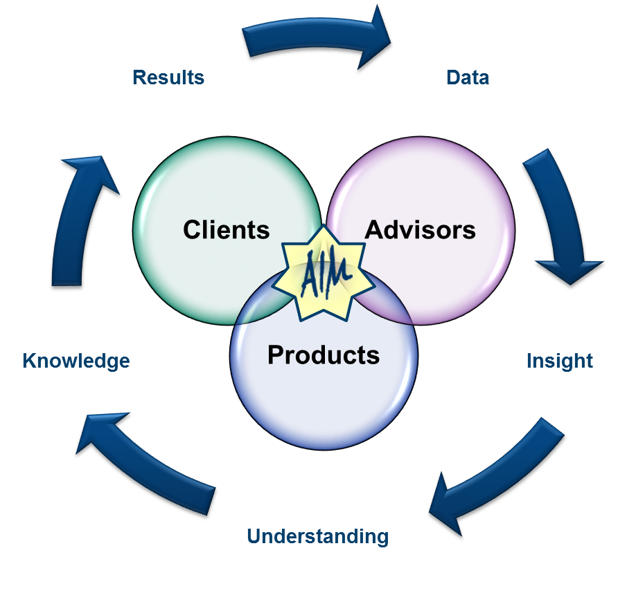
IM’s Charter is Targeting COMPANY Success
The Information Management vision is to deliver a sustainable competitive advantage to COMPANY by visibly driving information-based decisions and solutions. This vision includes making sure that our company is using data for systematic reasoning to make decisions. It includes targeting the right people with the right products and services at the right time. IM also plays a major role in developing an understanding the products, clients and advisors in our current business models.
IM’s 4 Cornerstone Capabilities: IM is a knowledge expert with an extremely broad base of information – and we know how to use it. By integrating people, tools and processes, IM provides the following solutions to COMPANY:
  Predictive Modeling
  Campaign Services
  Consultative Services
  Measurement Solutions
Key Linkages to Technologies:
  Data Management Solutions
  Business Intelligence
  Reporting and key metrics
  Strategic Measurement
    Integrated Financial Services Model: Information from Client, Advisor, Prospect, Product and Channel are brought together to drive information-based decisions and strategies

Slide 5
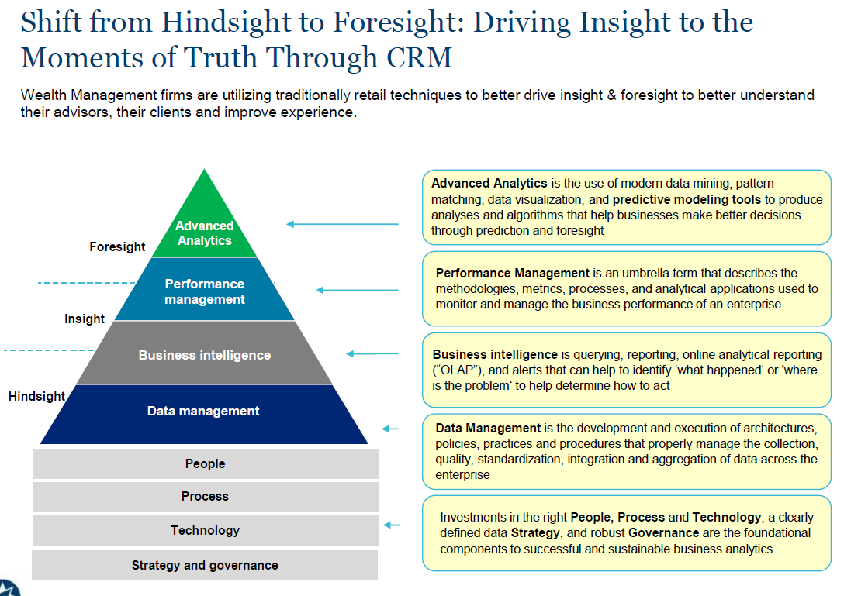
Example of Predictive Analytics in Action: CRM for the ABC
The COMPANY ABC Center is leveraging predictive analytics to drive insight for their CRM tools and customer strategies.

Slide 6
Example of Predictive Analytics in Action: Claims Fraud
IM is working closely with the COMPANY Claims area to identify high risk claims that are not getting reviewed in the current process. Due to the ever-changing nature of fraud, the process to detect it has to be continuously updated and improved. This requires a strong ongoing partnership between business and analytics. Below shows the continuous fraud detection cycle:
Continuous Fraud Detection Cycle*
System should be able to continually identify fraudulent activity
UNDERSTAND
Red Flags & Schemes
Regular meetings with business leaders and collections of new rules
Formal Feedback Mechanism – esp. important for false positives
Ongoing Tracking
Net Benefit Analysis
EVALUATE
SUI feedback & benefit analysis
BUILD
Fraud Detection Mechanism
Ongoing improvement of models – coverage, timing, data , methodology, fraud probability vs amount
Capacity Management with Thresholds
Business Rules & Suppressions
REFER
Business thresholds to refer claims to SIU
SCORE
Process to score for fraud potential
Improvements on the frequency of scoring – weekly to daily or real time
* From the article Innovations in Claim Fraud Detection by By Karthik Balakrishnan, Thomas Mulvey

Slide 7
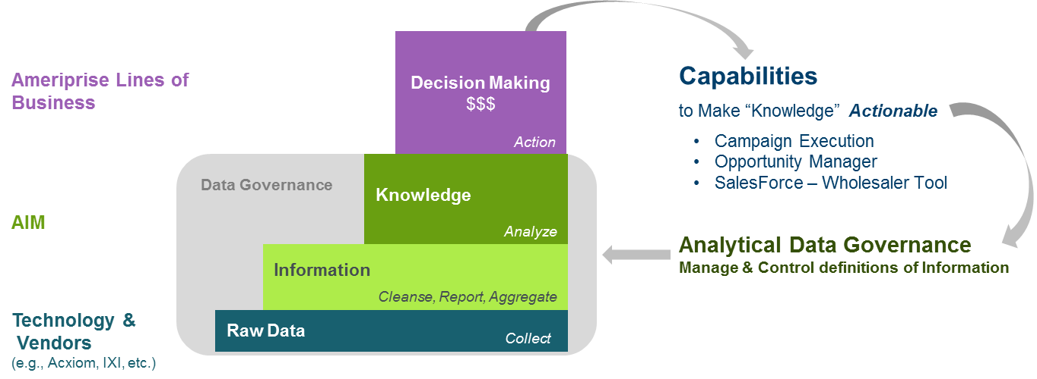
IM Data Asset – Data vs. Information and Knowledge
IM adds business value by utilizing and advancing raw data assets through statistical analysis
IM built an Analytical Datamart that includes the following forms of data:
  Raw Data – Regular feeds from Technologies
  Data with Insights:
    Information - collection of organized data with content and perspective
    Knowledge - the information that provides guidance or initiates action

Slide 8
Strategic Areas of Focus for IM
Long before there were slogans like “Big Data” or “A Smarter Planet” or “High powered Analytics,” IM was working to lay the foundations for our company to compete on analytics. At COMPANY, we see several clear analytic trends:
  Consistent increases in volume of requests
  Greater sophistication in the questions being asked
  A cultural shift towards using analytics across our organization
IM’s analytic foundation includes hundreds of data sources, the most complete customer picture in the industry, a robust prospect warehouse and almost ten years of data and metrics to use in decision making. We are proud of what we have accomplished and the results are consistently good:
  IM always delivers on time and operates above a six sigma level of quality
  We partner well and have established relationships with 500 different COMPANY Leaders, from ELT to Managers
  Our teams are global, virtual and operating effectively
  Our processes are auditable and our costs well controlled
  IM people are some of the most satisfied and engaged in the company and the industry

Slide 9
Fast Forward – Analytics at COMPANY in 2018
When we defined our first IM Roadmap in 2008, the world of analytics was vastly different. Facebook was still in its infancy and the iPhone had just come on the market. Since then, computing power has grown exponentially and the analytics industry has changed to the point where many industries live and die by the information they get from analytics.
Over the next five years, the pace will quicken and the companies that use analytics well will reap the rewards. Those who don’t will follow. While there is some need for continued investment to stay current with our platforms, we see the need to invest more in understanding and exploring what’s possible.
Big Data
  Emerging technologies will continue to expand data and re-define what’s possible
  Data from mobile and social media solutions will be born that require real time analytics
  COMPANY data solutions will be more dynamic and integrated
  Key Change: IM will have a bridge to Technologies and real time scoring in key business processes
Evolving Technology
  The technology will be faster, cheaper and easier to use
  Key Change: Extend value of data asset past IM, Banking and Cash Solutions and Compliance
  Analytic software solutions like R will be more visual and evolve to change current standards
  The way data is managed changes to handle volumes, integrate views and maintain security (e.g., Hadoop)
Vendors and Partners
  There are many evolving players – Accenture, McKinsey, etc. are all accelerating their presence in this space
  ACME is going big with analytics as their value proposition
  IBM is knocking on our door to showcase their view of the future
  Service Level expectations evolve and DR solutions are becoming more important

Slide 10

Conclusions – Moving Forward
IM has made significant progress against our last roadmap and expanded our impact into many parts of the company. We now want to focus on delivering an even greater strategic impact and to anticipate the company’s needs for tomorrow. IM High – we are in it to win it.
  IM has established capabilities in predictive analytics in many key parts of COMPANY, but analytics is a journey not a destination
  IM should focus on the biggest and highest value opportunities
  For each opportunity, start with questions not data
  Keep existing capabilities while adding new ones
  Use an information agenda to plan for the future
What We Need From Technologies:
  Support in influencing the culture –
  Keep thinking long term – COMPANY needs a business intelligence strategy
  Data will drive tomorrow’s opportunity (it wisely)
analytics is a journey, not a destination

Slide 11
Appendix
End-to-End Across COMPANY: An Integrated Model
Current Hardware Environment at ACME
Current Services from ACME

Slide 12
End-to-End Across COMPANY: An Integrated Model
The power alley for COMPANY is the fact that we are fully integrated financial services team. IM’s power alley is the ability to understand the crossroads of products, customers, advisors, investors and prospects. Many of our deliverables are focused at the department or segment level. We believe an approach that brings together the end to end view for (with measurement) is a key step forward.
Full Enterprise View (A Measured COMPANY)
  A granular view for each advisor
  A flexible view across programs and across segments
  Measures all key metrics and provides a financial measure (e.g., NPV)
IM Vision Across the Company
  Full view of customer or investor (some missing pieces)
  Full view of Advisor (internal and external)
  Full view of Field and Sales Leaders (field leader data unavailable)
  Full view of integrated firm (an enterprise view)
Metrics Solution
  Access to data asset for broader group than
  IM, Compliance and the Bank
  Key metrics reactive and proactive at the finger tips of leaders
  Simple, organized and secure
  Insight at fingertips of those who need it

Slide 13

Current Services from ACME
IM’s largest expense is the AbiliTec services at $1.2 million, which internally we call “pinning.” This service is essential for identifying lead conversion.
AbiliTec®
Becky Wilson
123 1st Ave
Phoenix AZ
DOB: 7/4/60
Becky Smith
45 Oak St
Chicago, IL
DOB: 7/4/60
Married & Move
Data
Verified Data
Name
Change
Link = ABC123
Rebecca Jones
12 Main St
Atlanta GA
Becky Smith, IL?
Rebecca Wilson, AZ?
Becky Wilson? GA?
120 Main Ave, GA?
Rebecca Wilson
123 1st Ave
Phoenix AZ
Rebecca Jones
12 Main St
Atlanta, GA
30301-0708
(312) 223-0065
(312) 223-0065
Rjones@yahoo.com
Rebecca@business.com
Re-married
& Move

